Slide 1


BIG DATA - BUAN - 6346
Semester Project
Group Members:
Mourlaye Traore (mxt230013)
Lal Reddy Indla (lxi220003)
Kiran Kumar Reddy Kanchani(kxk220082)

Slide 2



Introduction
Project Objective: Identify actionable business insights by formulating key questions to guide our analysis of datasets.
Analysis Tools: We used Hadoop and Spark for data processing and used Tableau for dynamic visualization of our findings to illustrate key insights clearly.
Expected Outcomes: Aim to uncover valuable business insights and provide informed recommendations that will drive business growth and enhance operational efficiency through detailed data analysis.

Slide 3
Dataset Overview
Dataset Composition: Our "Liquor_sales" dataset, sourced from Kaggle, encompasses two Excel files, of 648 MB, and 4.77 GB from two difference sources roughly 3 million records across 24 columns,, documenting detailed spirits purchases by Iowa Class "E" liquor licenses.
Dataset Details: Each record in the dataset provides comprehensive insights, capturing the date of purchase, product specifics like type, brand, and alcohol content, as well as financial data including cost and quantity purchased.
Analytical Applications: The extensive data enables deep analysis of regional and temporal sales trends, aiding retailers in stock optimization and marketing, while providing policymakers data to gauge the economic dynamics of liquor sales in Iowa.

Slide 4
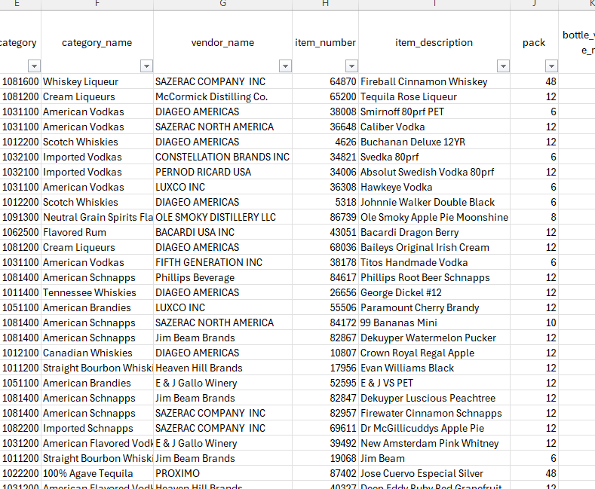
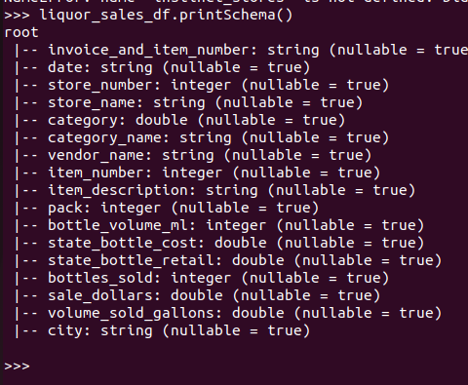
Dataset Overview
Dataset in Excel
Dataset Imported in Pyspark

Slide 5
Business Questions
Stores and Categories Performance: How do store order volumes and liquor product sales volumes correlate with total dollar sales at both the store and product levels?
Pricing Strategy: How does pricing affect the volume and profitability of liquor sales, and what are the optimal price points for various categories to enhance revenue?
Vendor and Category Profitability: Which vendors and product categories contribute most to the store’s profitability, and how can this information improve vendor negotiations and inventory decisions?

Slide 6
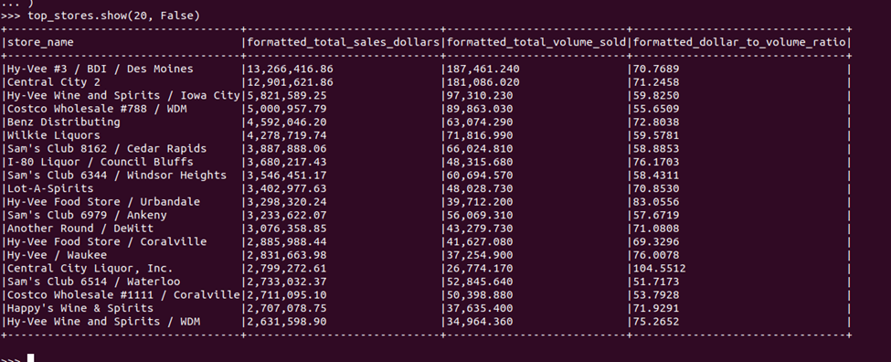
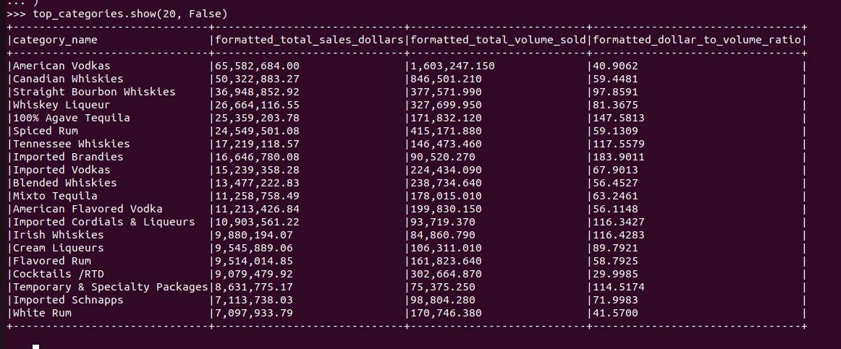
Question 1: Stores and Categories Performance
Liquor Stores
Liquor Categories

Slide 7
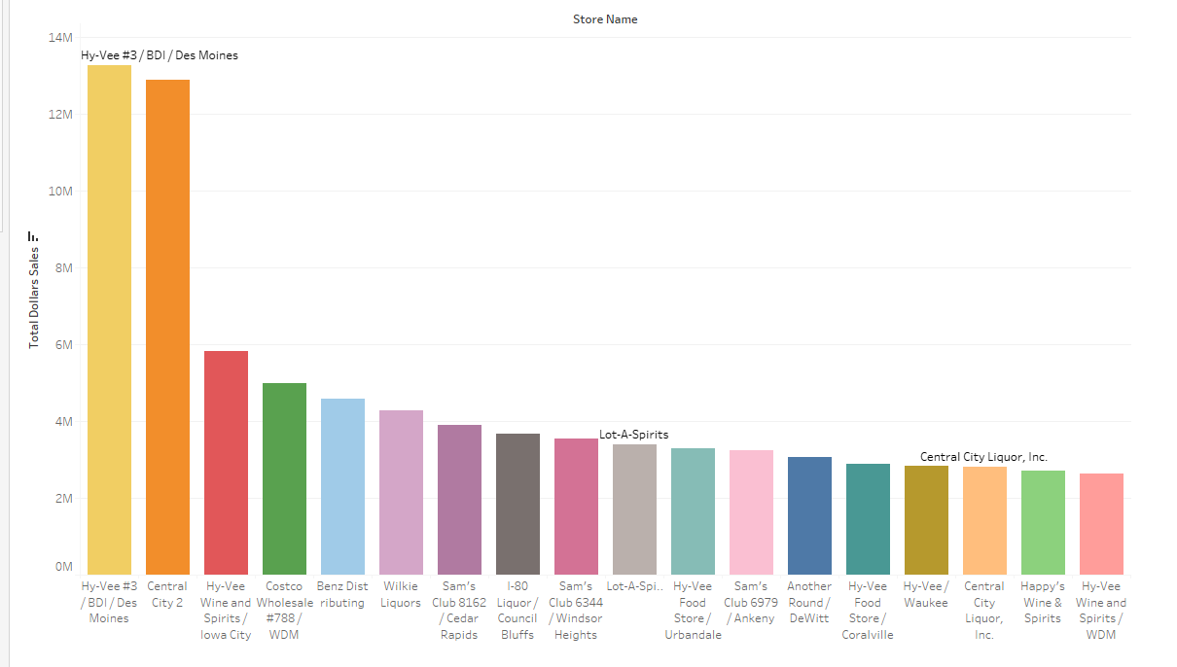
Top 20 Liquor Stores based of Total Revenues
Based on the revenue, two major stores are leading:
Hy-Vee #3 DB / Des Moines
Central City 2

Slide 8
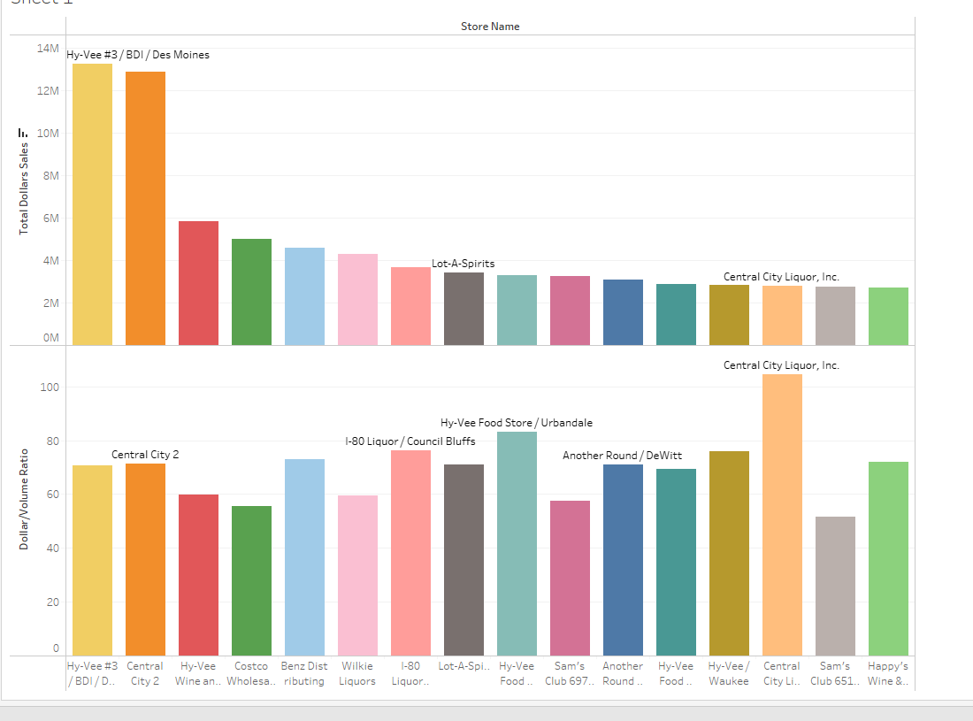

Top 20 Liquor Stores based of Total Revenues
The dollar-to-volume ratio provides a refined measure of store performance, revealing differences in effectiveness beyond mere sales and volume metrics.
Central City Liquor, Inc. boasts a higher dollar-to-volume ratio of 104.55 on $2.8M in revenue.
Despite its strong sales, Costco Wholesale #788 / WDM has a lower dollar-to-volume ratio of $55.6, indicating a strategy that prioritizes volume over higher profit margins per unit

Slide 9
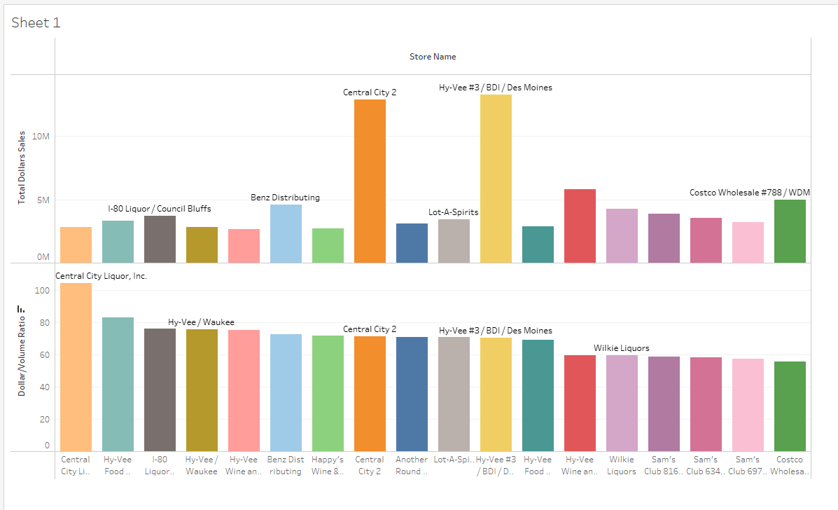

Liquor Stores ranked based on the dollar/volume ratio
The two top are ranked 11th and 8th based on dollar to volume ratio
The two store with more revenue potential are Central City Liquor and H-Vee Food Store Urbandale

Slide 10
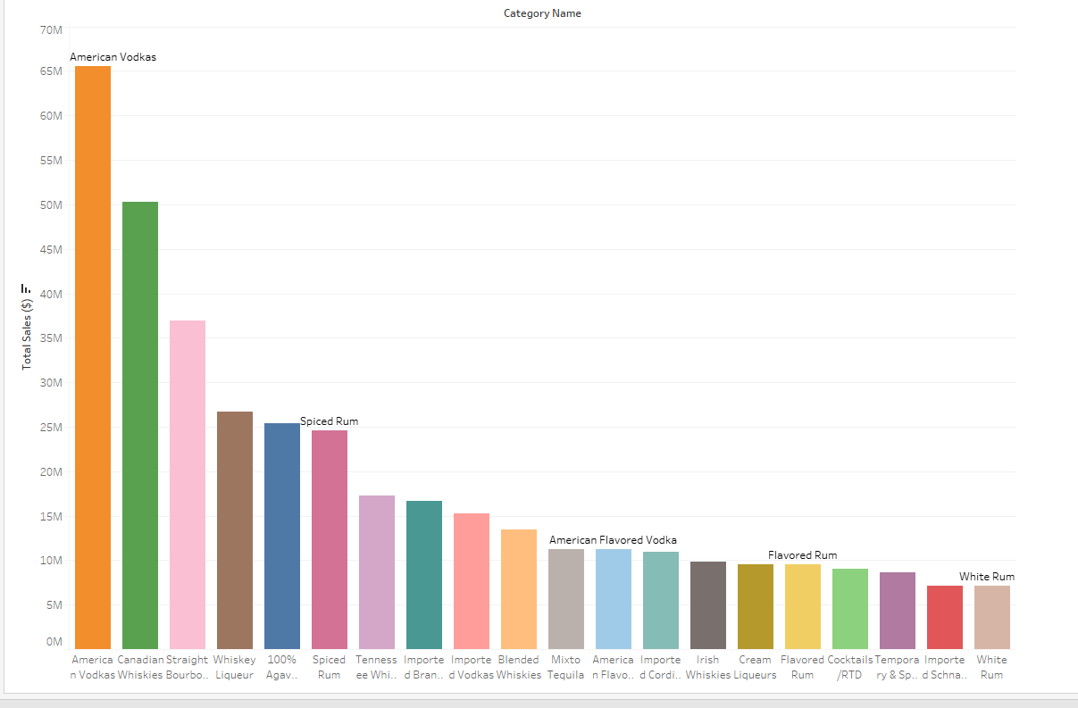
Top 20 Liquor Categories ranked by revenues
Rank shows that American Vodkas, lead with the most revenue 65M
Followed by Canadian Whiskies and Straight Bourbon Whiskies

Slide 11
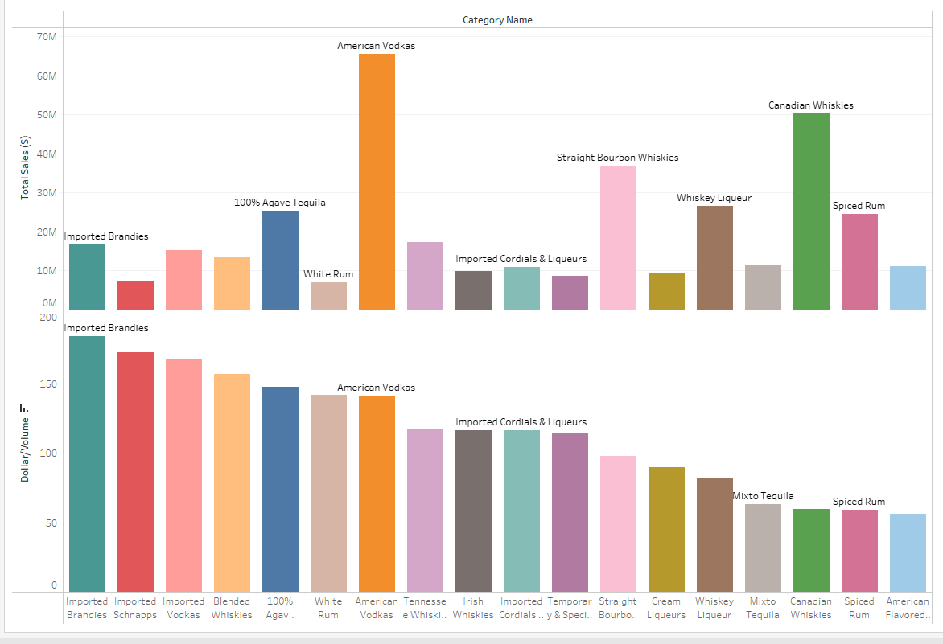

Top 20 Liquor Categories ranked by revenues
Even though with the highest revenue of $65M, American Vodkas yet exhibit a lower profitability ratio at $41, ranked 7th
Imported Brandies, despite lower total revenues of $16M, achieve the highest dollar-to-volume profitability at $184 per gallon
100% Agave Tequila demonstrates a balanced approach with a dollar-to-volume ratio of $147.38, indicating a strong market position.

Slide 12
Conclusion and Recommendations
Optimize Merchandising Strategies: Capitalize on the success of high-performing stores like Hy-Vee #3 / BDI Des Moines by analyzing and adopting their effective practices in product selection. Additionally, explore merchandising strategies that enhance the dollar-to-volume ratio, to increase their profitability without compromising on sales volume.
Enhance Inventory Allocation: Given the varying dollar-to-volume ratios, stores could optimize inventory levels based on sales performance and profitability. For instance, Hy-Vee Food Store / Urbandale and Central City Liquor, Inc., which show relatively high dollar-to-volume ratios, suggest that customers there may prefer premium products. The business could increase the stock of higher-end liquors in these stores.
Expand Premium Selections: With Imported Brandies having the highest dollar-to-volume ratio, there's an indication that consumers are willing to pay more for premium products. The business should consider expanding its selection of premium brands and specialty products in other high-margin categories, such as Whiskey Liqueur and 100% Agave Tequila, to capitalize on this trend

Slide 13

Question 2
"How does pricing affect the volume and profitability of liquor sales, and how do adjustments in pricing influence the sales quantities across different categories?"

Slide 14
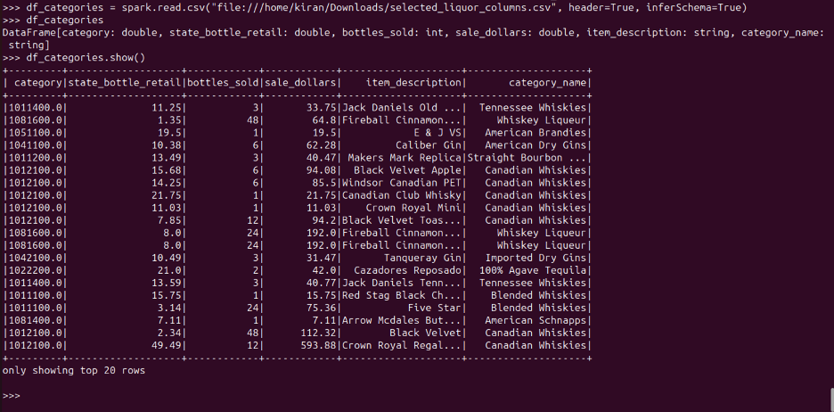
Sample Data Overview

Slide 15
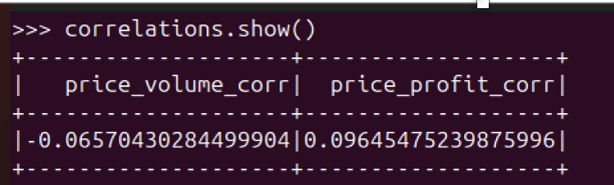
Correlation Analysis
we are examining the strength and direction of the relationship between the prices of products and their sales volume and profitability.

Slide 16
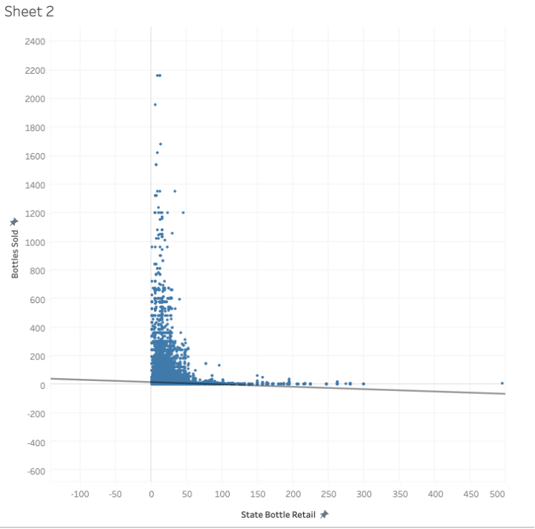
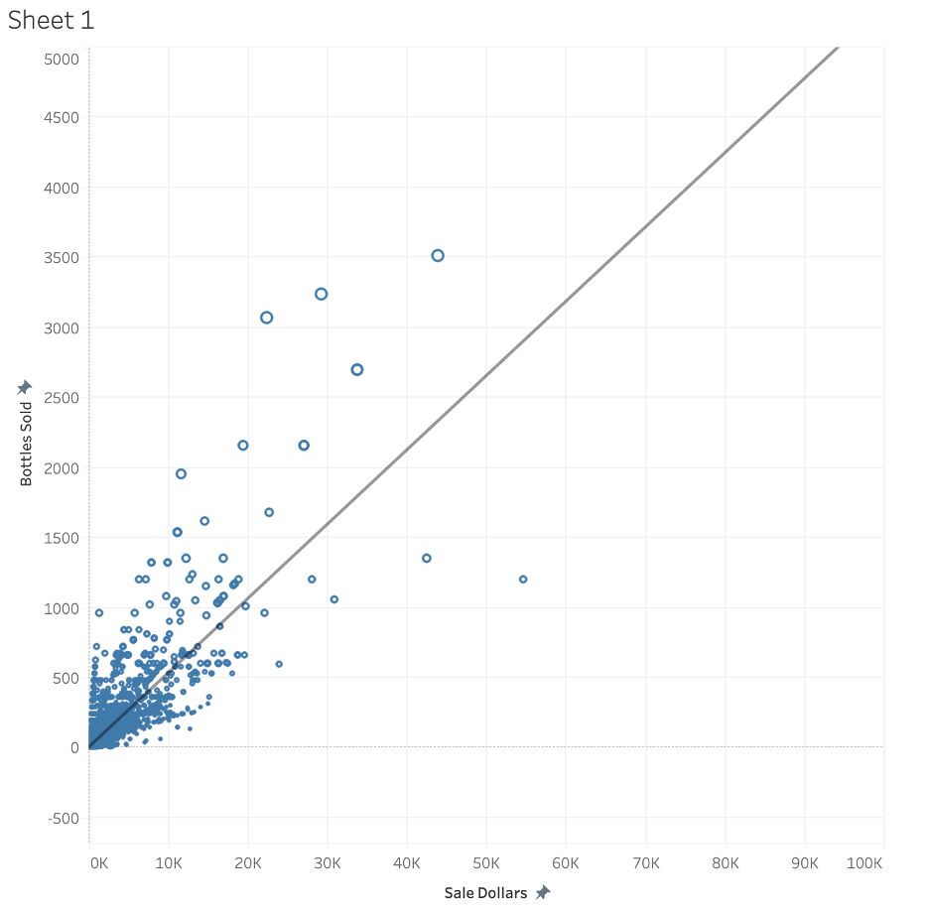
State Bottle Retail vs Bottle sold
Sale Dollars vs Bottle Sold

Slide 17
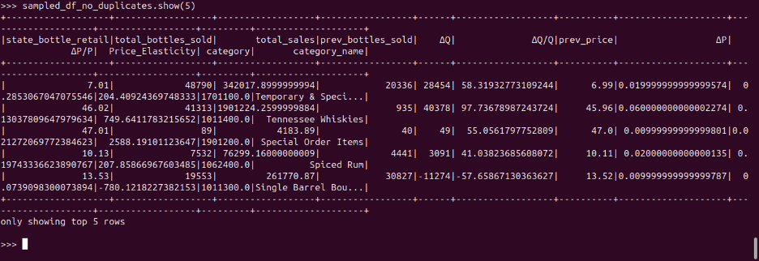
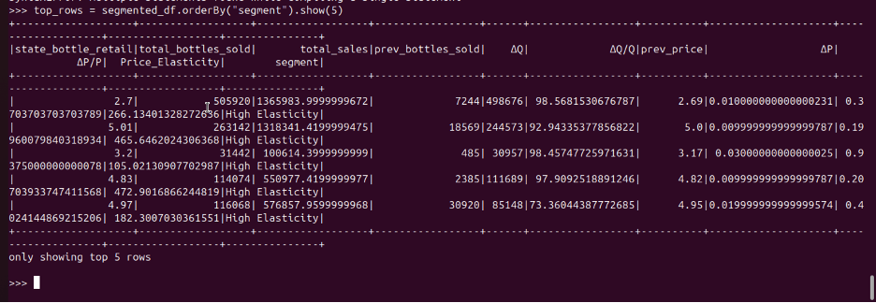

Slide 18
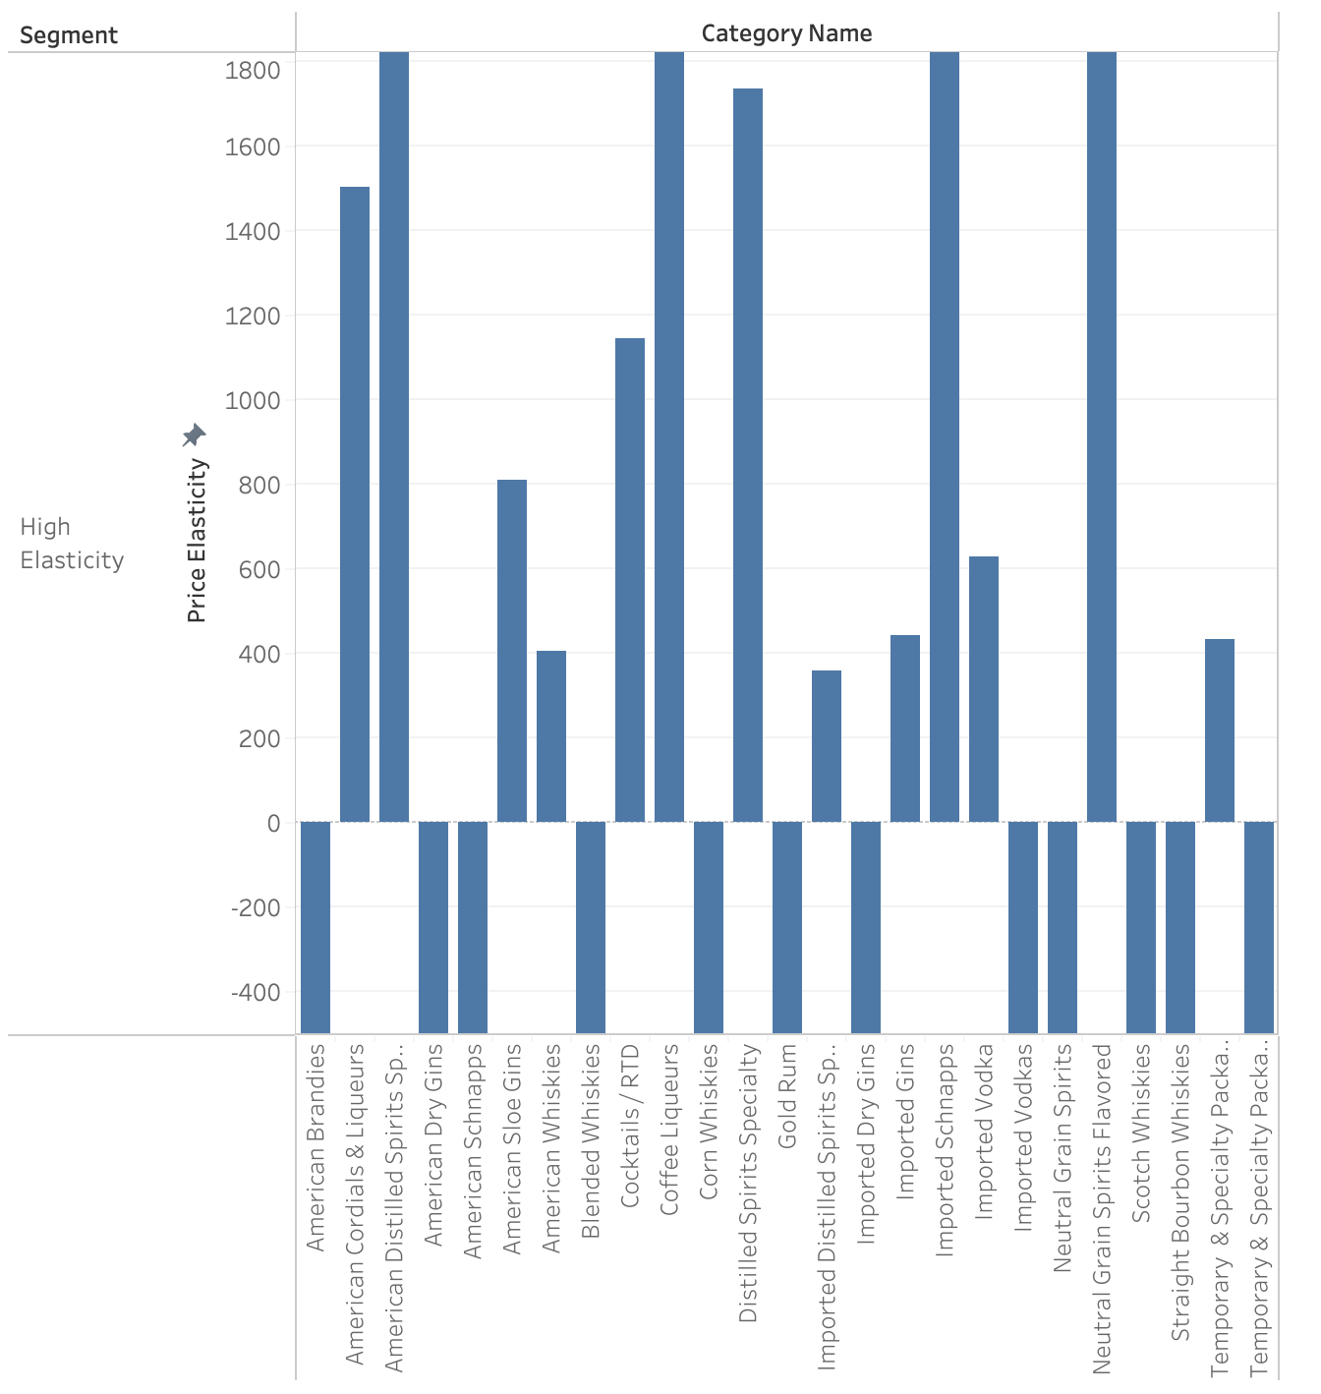

Slide 19
High Elasticity: Categories with bars above the horizontal axis have positive elasticity, meaning sales increase when the price drops and decrease when the price rises. Taller bars indicate greater sensitivity. For these categories, even a small change in price could lead to a large change in the quantity sold.
Low or Negative Elasticity: Categories with bars below the axis have low or negative elasticity. Here, changes in price have a less significant impact on the quantity sold, or sales might even go up when the price increases. Some of the High Elasticity Categories 1.American Cordials & Liqueurs
2.American Distilled Spirits Specialty
3.Cocktails / RTD
4.Coffee Liqueurs
5.Distilled Spirits Specialty

Slide 20
Question 3
Which vendors contribute most to the store’s profitability, and how can this information improve vendor negotiations and inventory decisions?

Slide 21
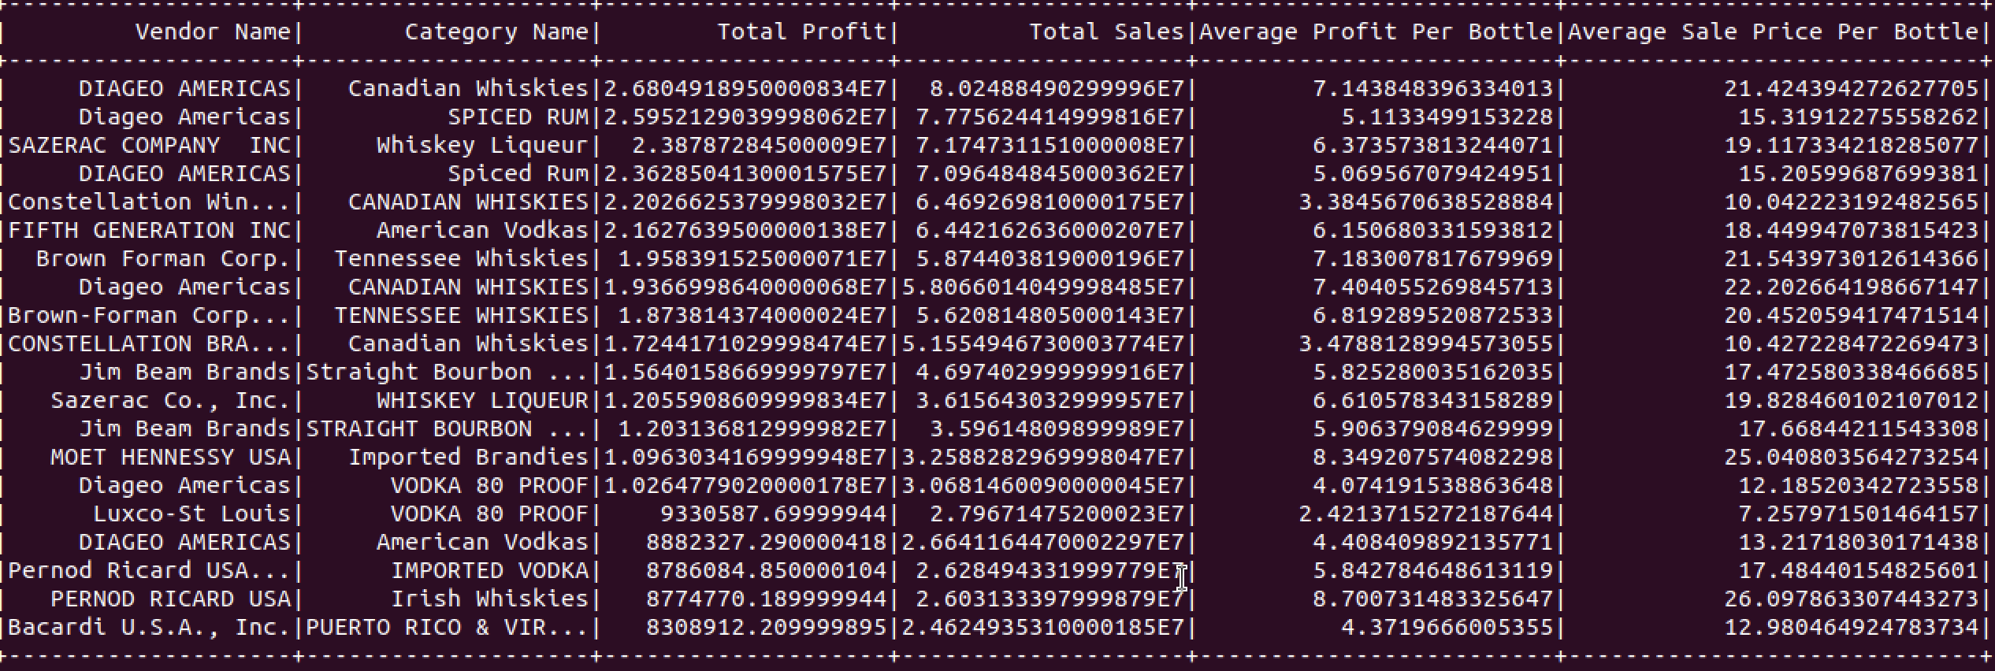
Query Result

Slide 22
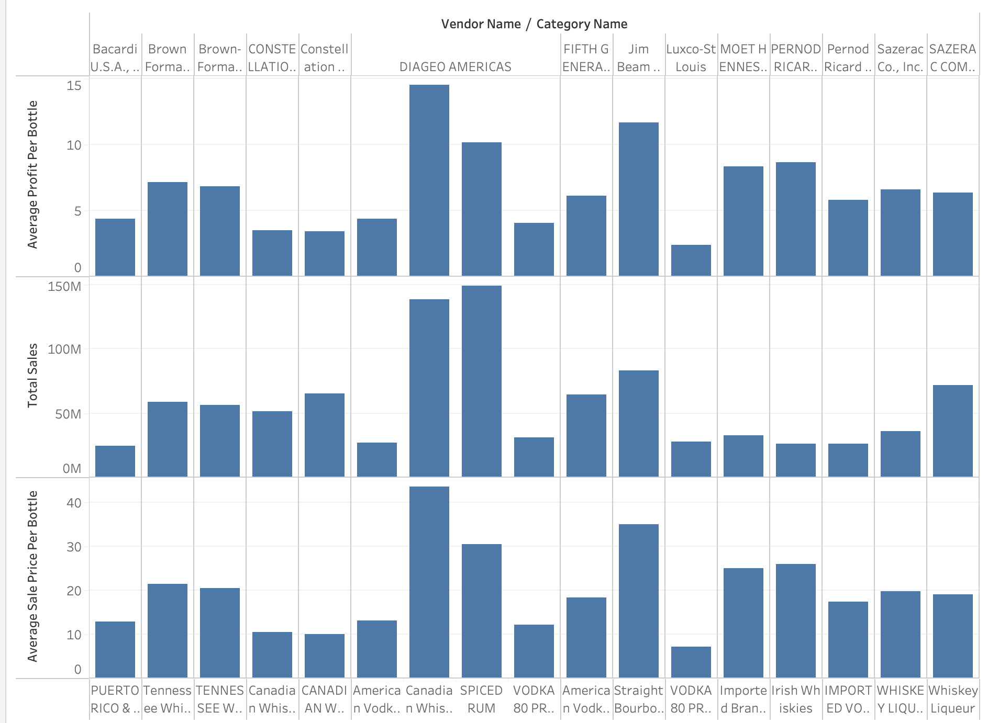
Vendor/Category vs Sales/Profits

Slide 23
Contributions to Profit
1. As DIAGEO AMERICAS, stands out prominently, particularly in the categories of Canadian Whiskies and Spiced Rum.
· Marketing efforts, such as joint promotional campaigns or sponsored events with DIAGEO AMERICAS could drive sales and enhance brand visibility for both parties.
· Exclusivity in stocking, or first access to new product lines, and prioritize shelf space and positioning for Canadian Whiskies and Spiced Rum, and the new line products could give the company a competitive edge in the market.
2. Sazerac Company's presence in the Whiskey Liqueur category have a balanced approach between volume and profitability whereas it's average sale price suggests a room for pricing strategy.
· Competitive pricing strategies might increase the volume of sales for Sazerac products, which could offset the lower margin per unit and lead to higher overall profits capturing a larger market share.

Slide 24
Thank you

Slide 26
Project Objective: Identify actionable business insights by formulating key questions to guide our analysis of datasets with enough size > 200MB.
Analysis Tools: We used Hadoop and Spark for data processing, while leveraging Tableau for dynamic visualization of our findings to illustrate key insights clearly.
Expected Outcomes: Aim to uncover valuable business insights and provide informed recommendations that will drive business growth and enhance operational efficiency through detailed data analysis.

Slide 27
Just Draft

Slide 28
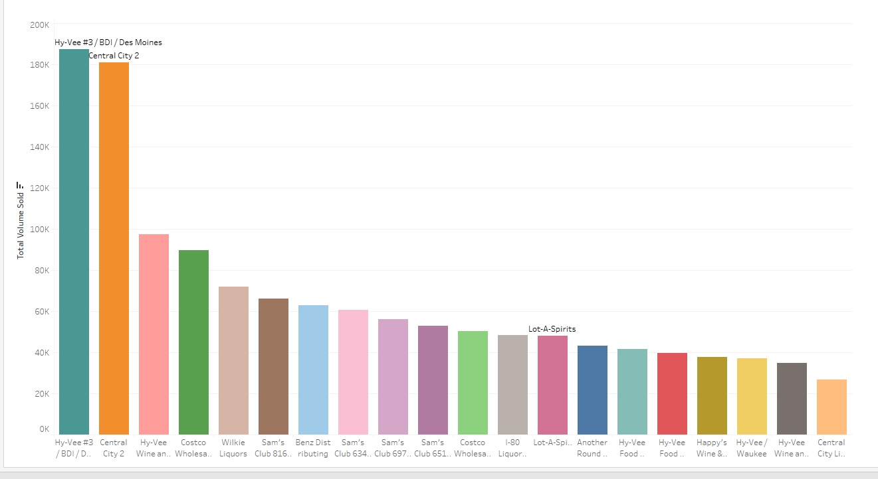
Liquor Stores by volume sales

Slide 29
